Slide 1

SORORITY
Info 5100
A woman’s healthcare project by
BIT-BY-BIT
TRISHA GHORPADE-(002920687)
GLORIA SINGH-(002960072)
SREYOSHI GHOSH- (002924715)

Slide 2

INTRODUCTION
The application provides a health care and security solution for women. Our application will give a risk analysis of the most common health problems related to women. It provides the female user as a customer with a period tracker. It will enable the female user to complain about any type of violence or sexual harassment, if they consent to report the case then the medical results after the examination of the female’s body will be directly sent to the police department for investigation and to the lawyer as well. This feature is developed because sometimes the violence starts at home and women do not feel safe to report that incident or sometimes, they are not comfortable sharing the details of that horrendous encounter with everyone all the time. They will get a list of NGOs nearby based on their pin code where they can go for help.. The reception will generate an appointment email to the user. Project aims to establish connection between different enterprises for a better flow of operation.

Slide 3
CONTRIBUTIONS
Tris
Trisha
Enterprise Panel, Work Area Panel, Female User, Nurse Panel
Gloria
Police Panel, Lawyer Panel, Appointment Panel, Doctor Panel
Sreyoshi
Pharmacy Panel, NGO Panel, Doctor Panel, Reception

Slide 4
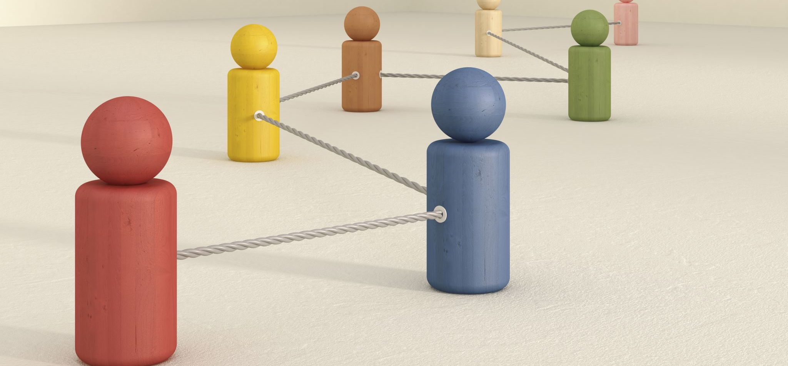
enterprises and Organization

Slide 5
NGO
Police
Hospital
Judiciary
Enterprises

Slide 6
Doctor
Reception
Pharmacy
Examination
Nurse
Lawyer
Police
NGO

Slide 7
Lawyer
System Admin
NGO
Examination admin
Nurse
Work area Admin
Female users
Reception
Doctors
Pharmacy
Police

Slide 8
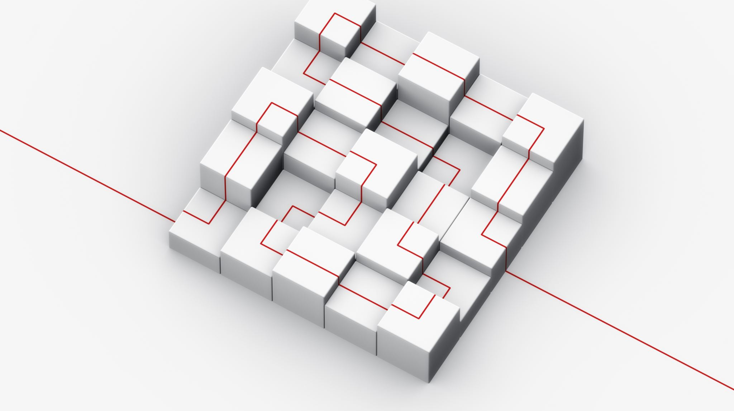
Architectural diagram

Slide 9
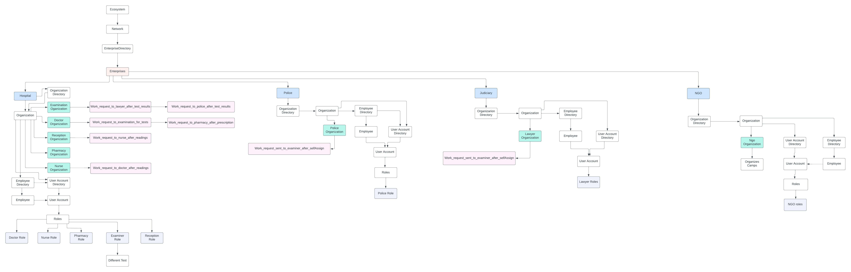

Slide 10

UML diagram use-case

Slide 11
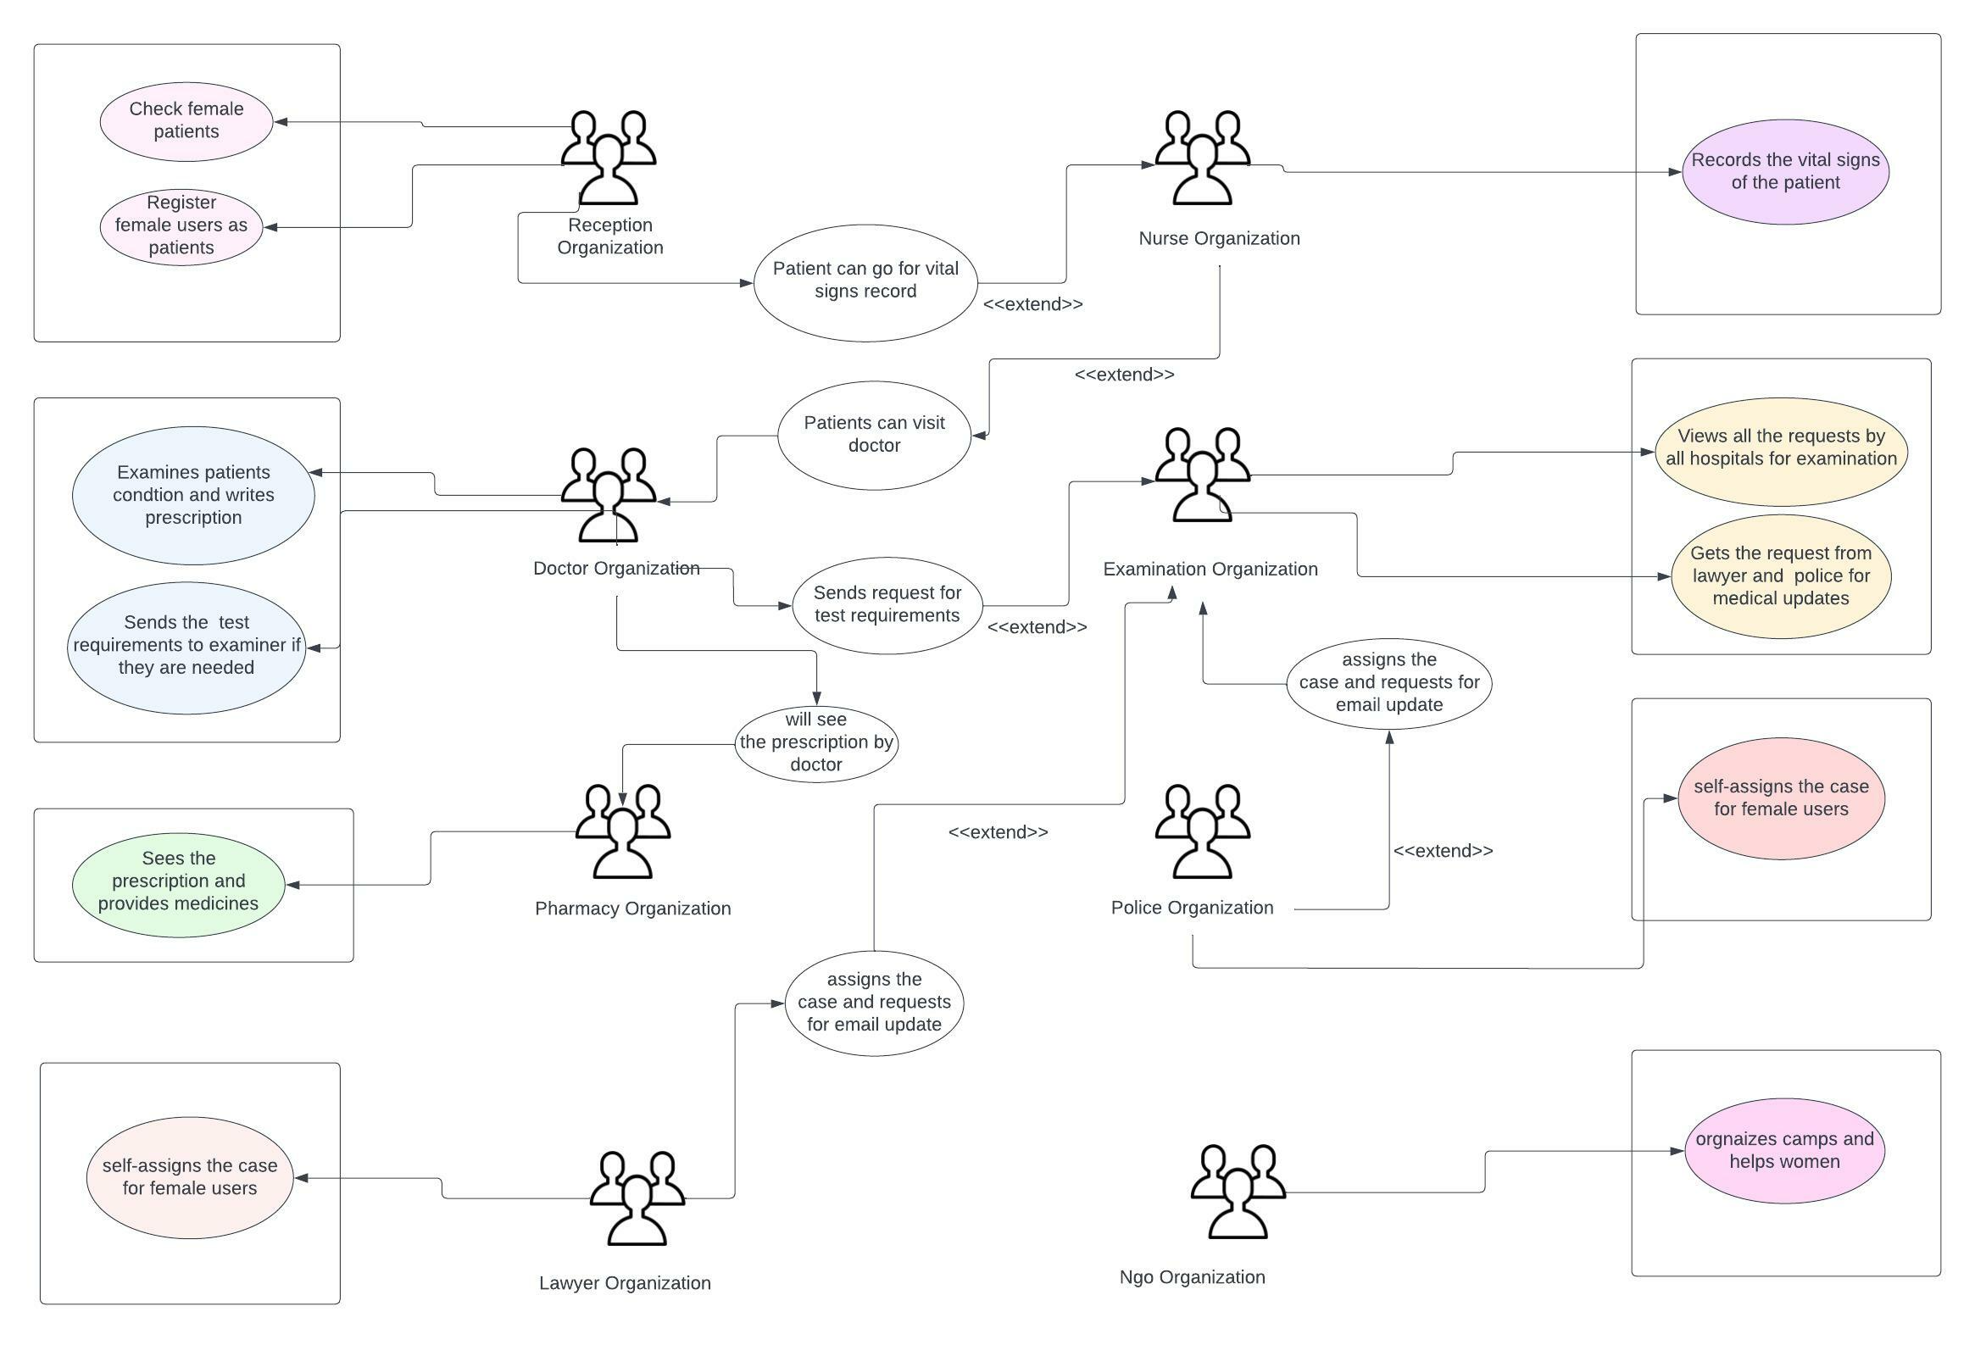

Slide 12

Class diagram

Slide 13
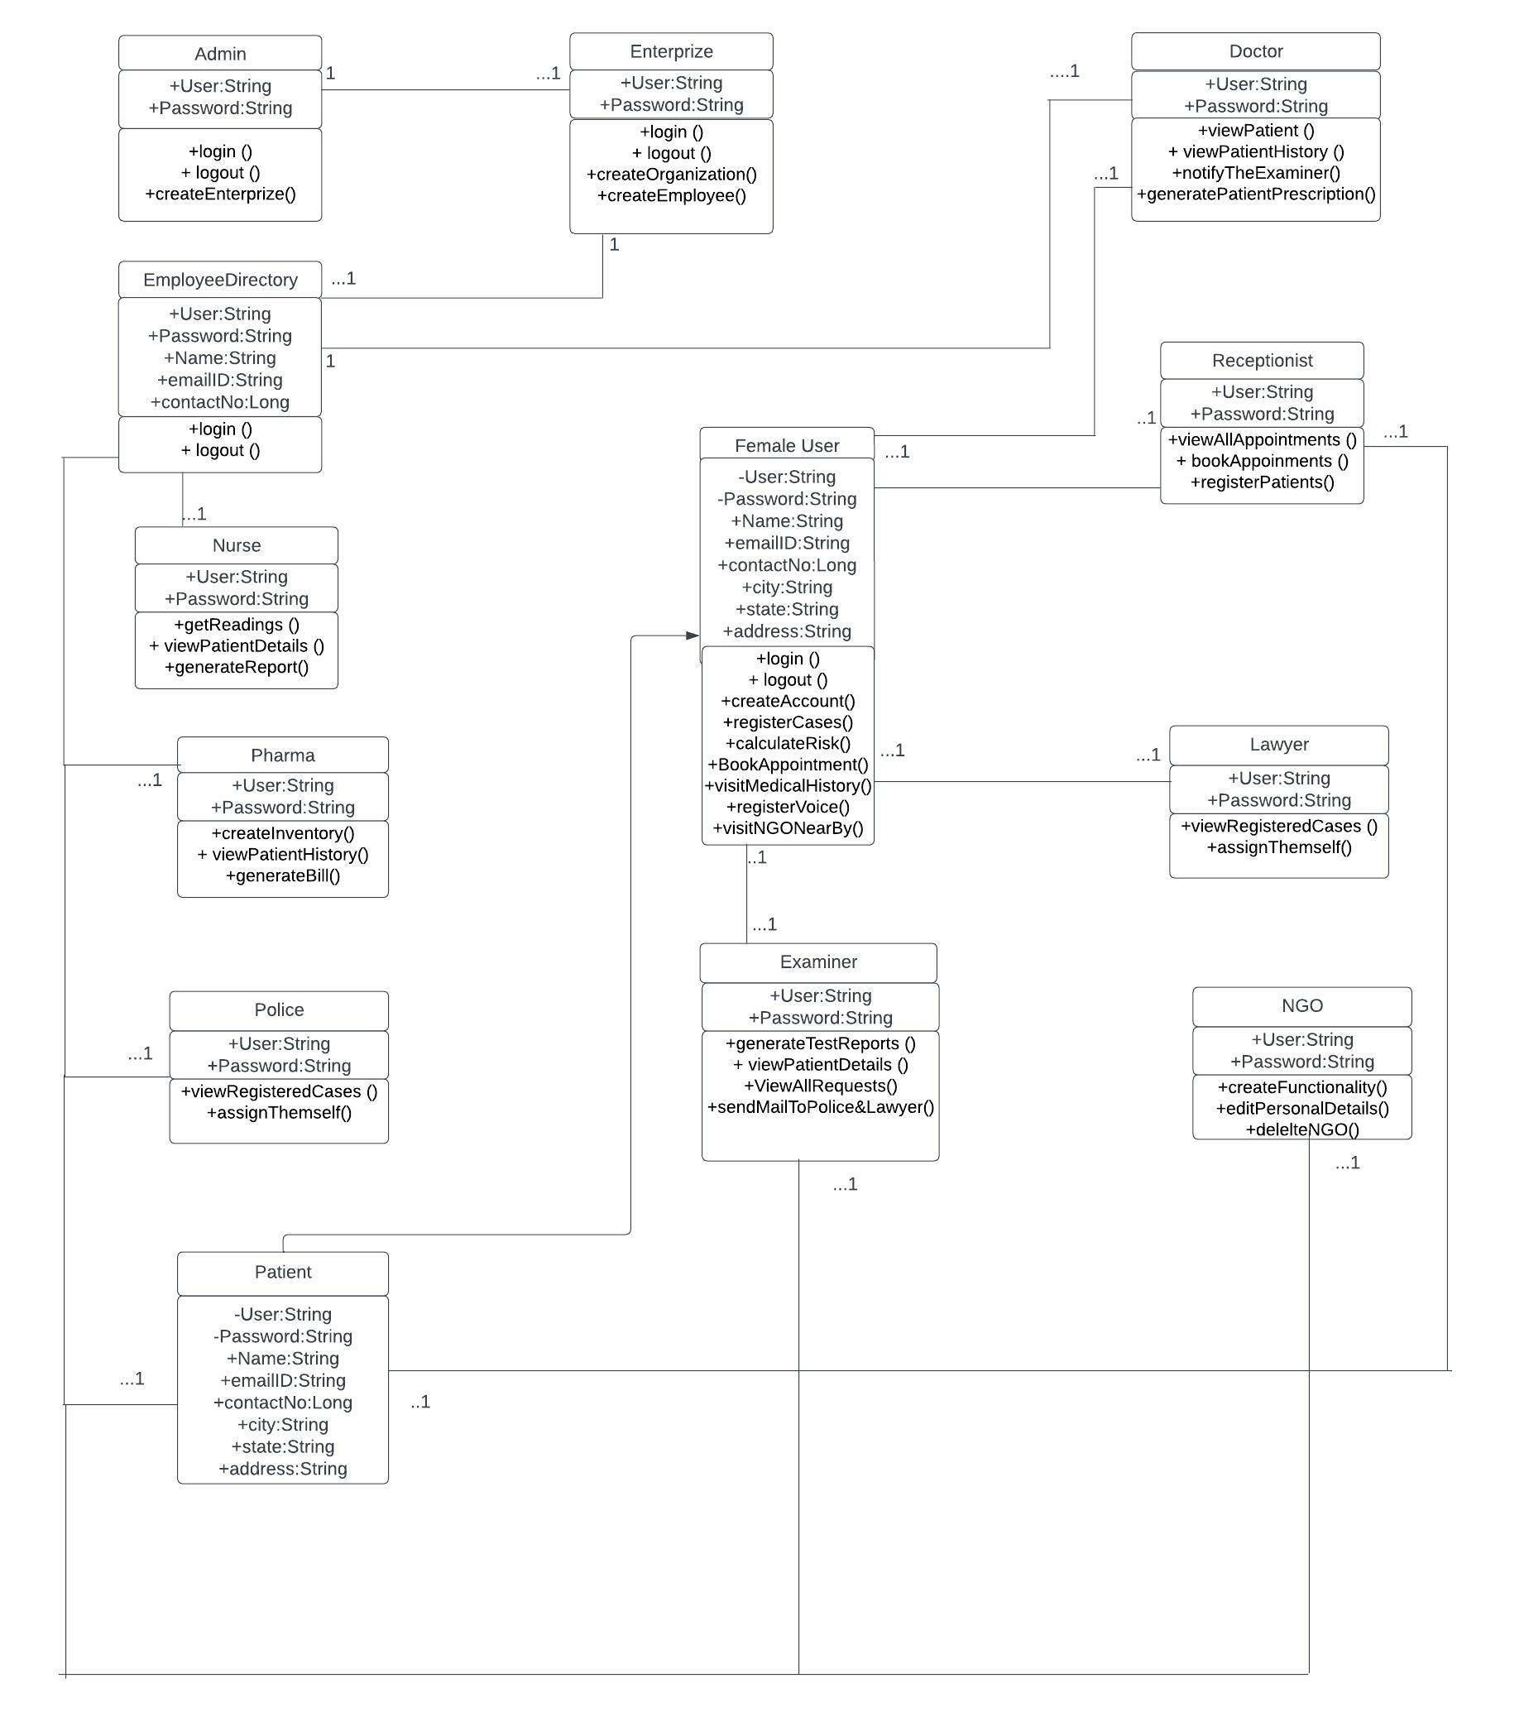

Slide 14
Implementation process
This project has used the implementation techniques of Agile development.
The project tracking was created inside GitHub and different roles and tasks were assigned to the team members, peer review and testing were also involved in that process.
A separate organization was created to build this project bit-by-bit. New members were created inside that organization.

Slide 15
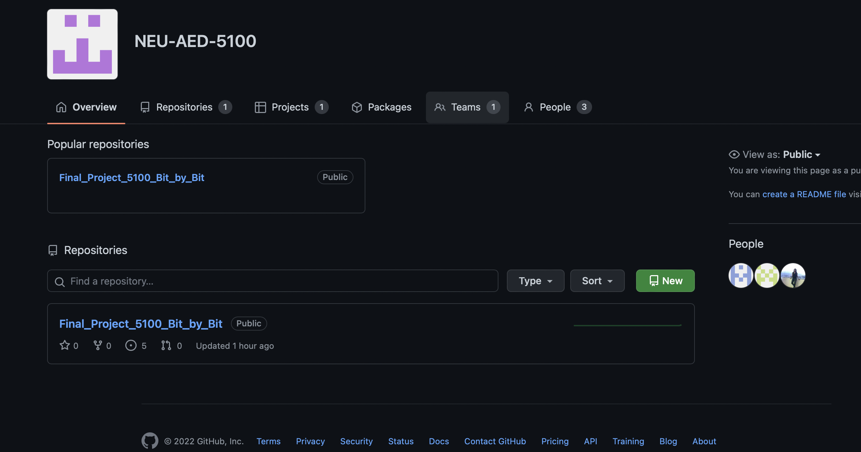

Slide 16
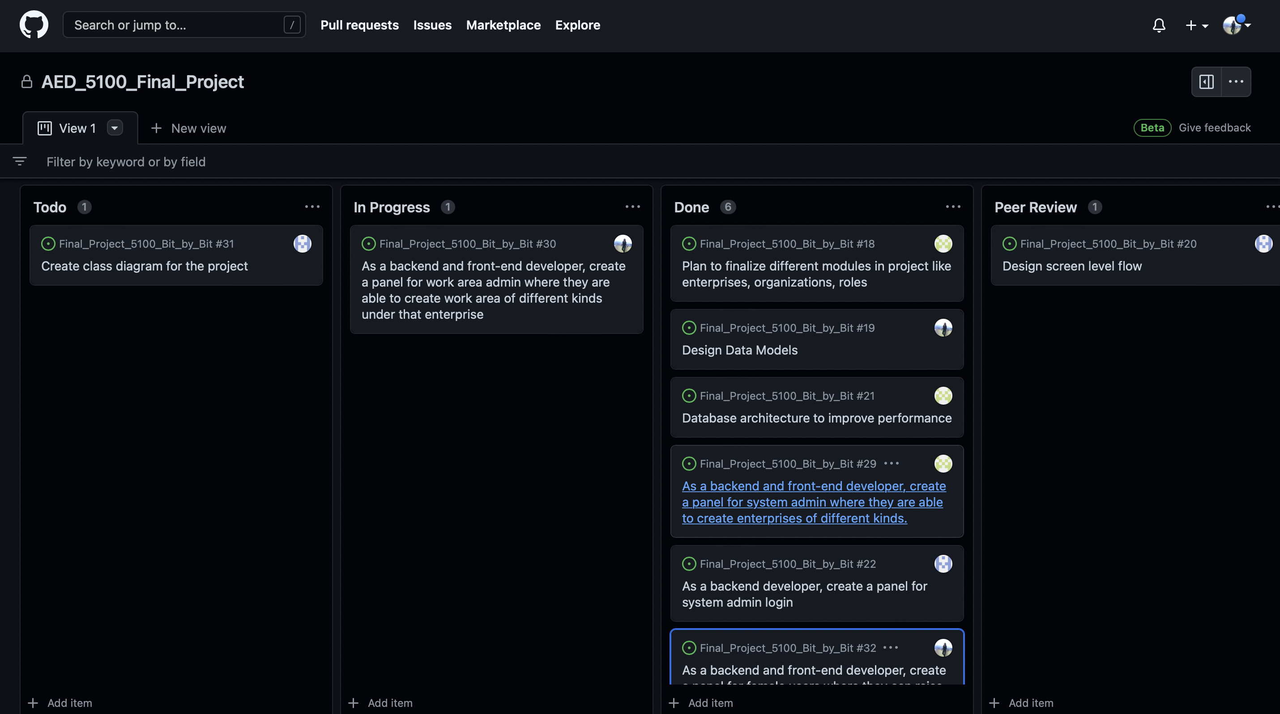

Slide 17

Summary module for admin

Slide 18
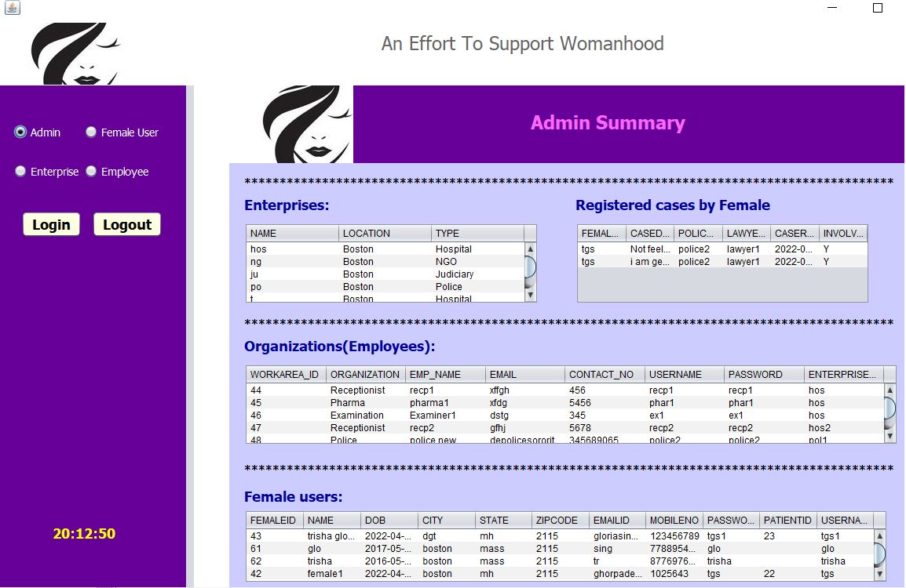

Slide 19

Workflow

Slide 20
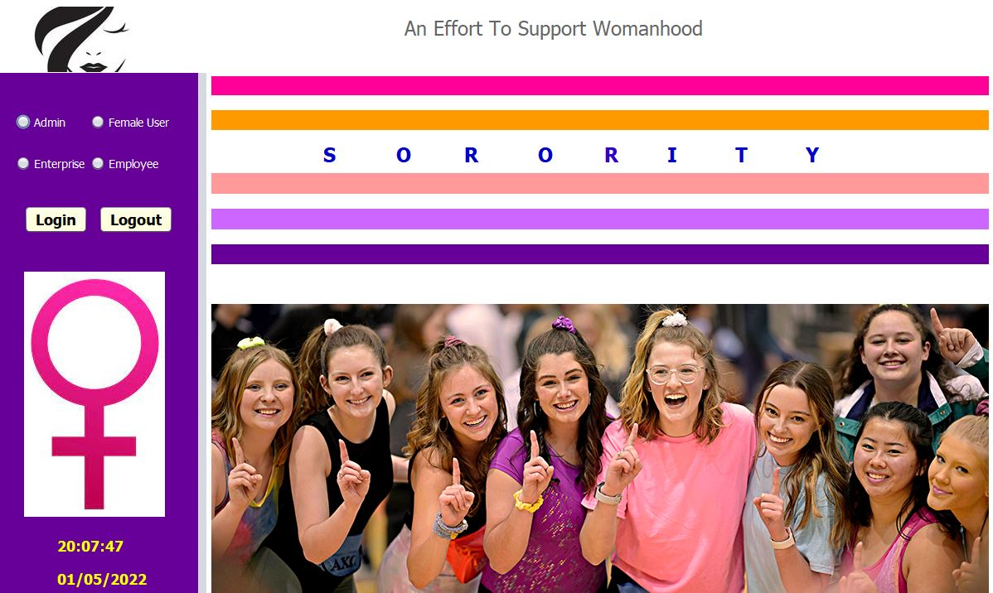
Landing page

Slide 21
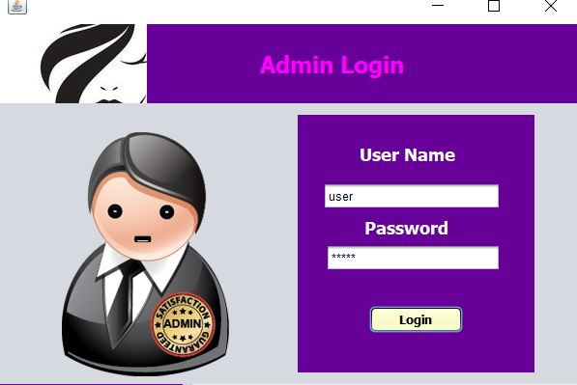
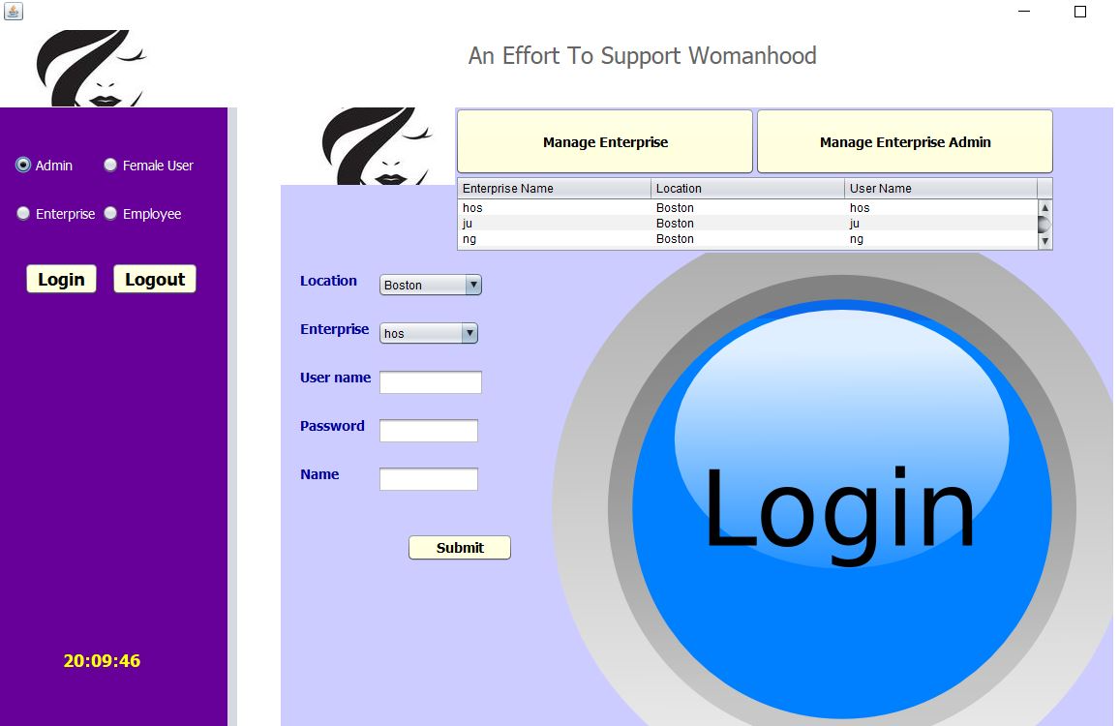

Slide 22
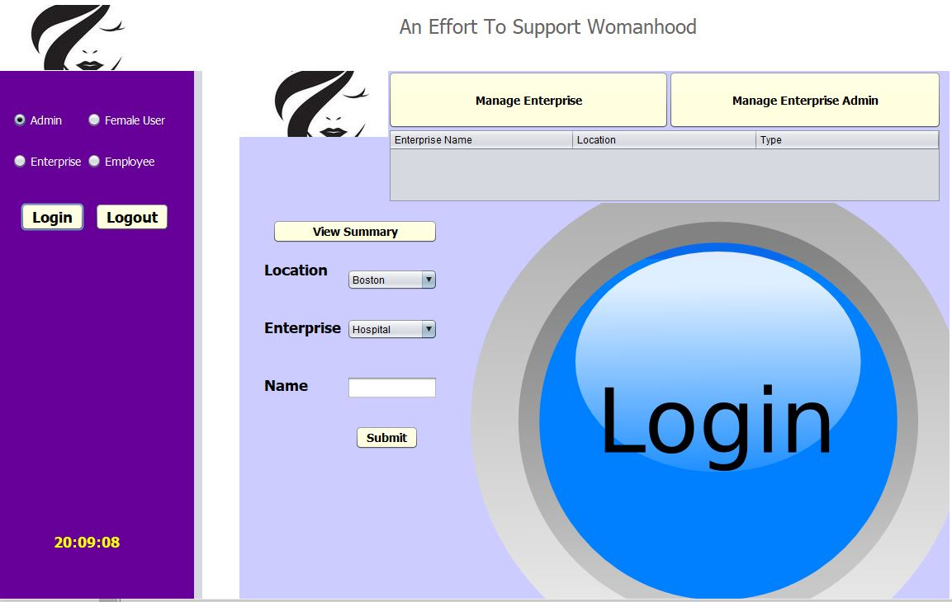
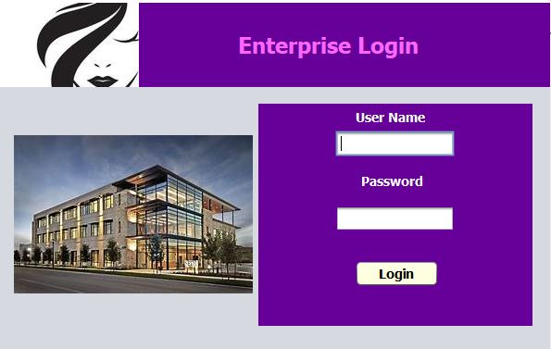

Slide 23
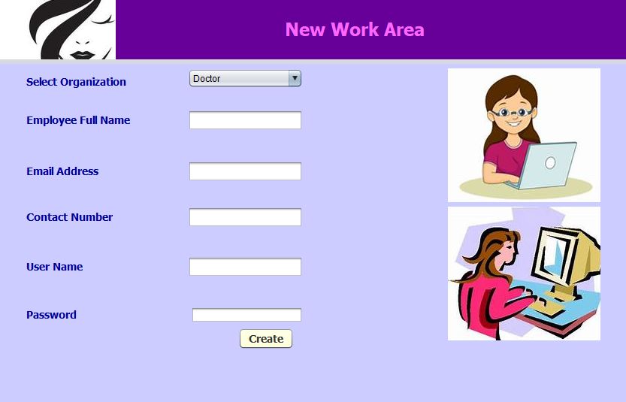
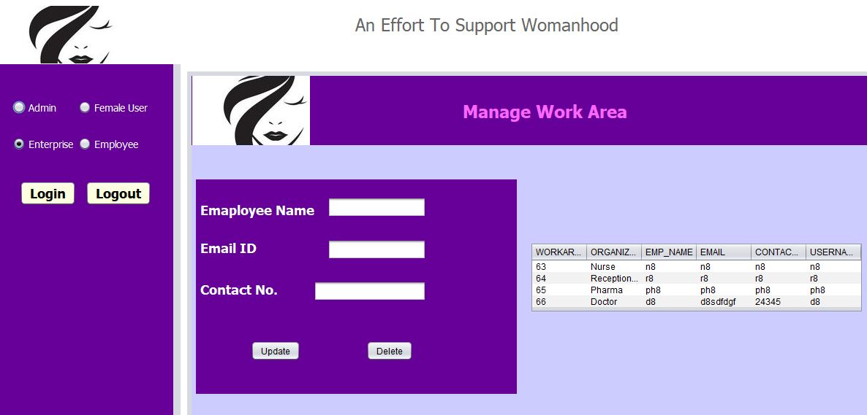

Slide 24
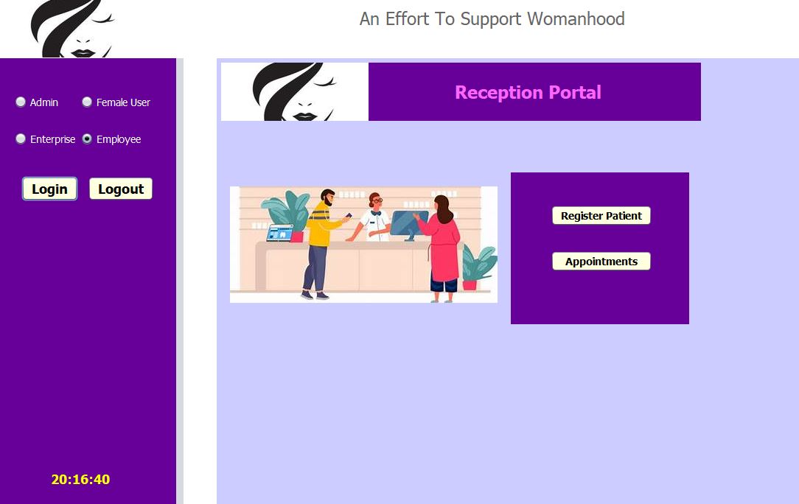
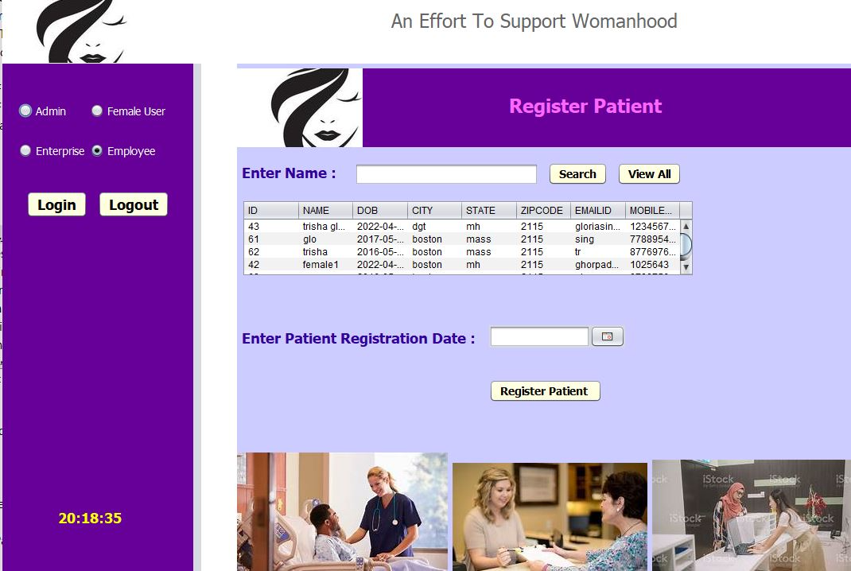

Slide 25
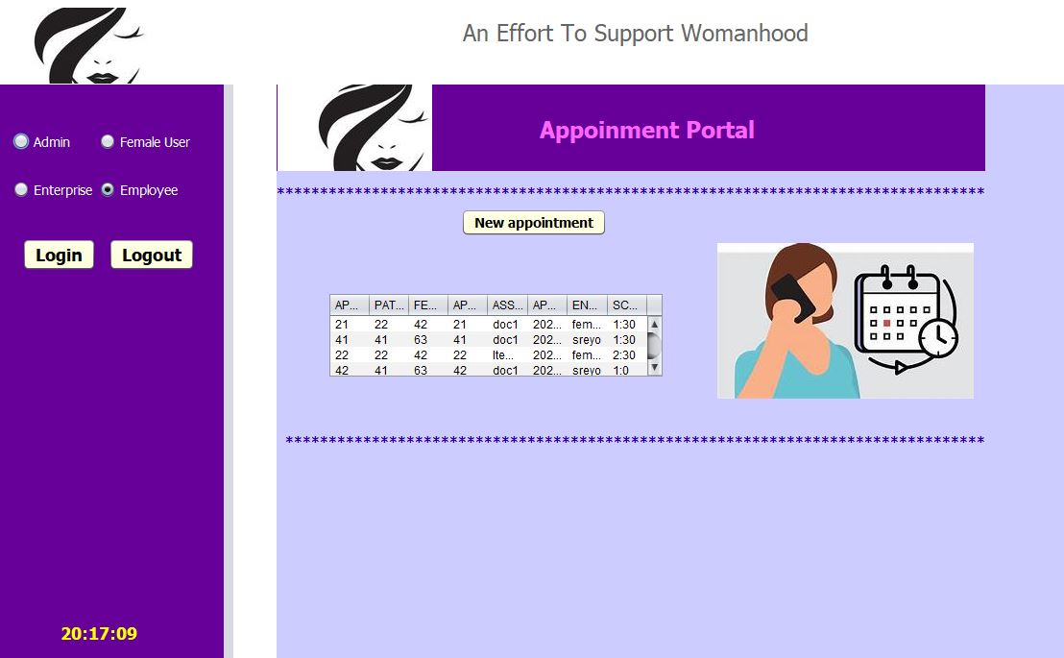
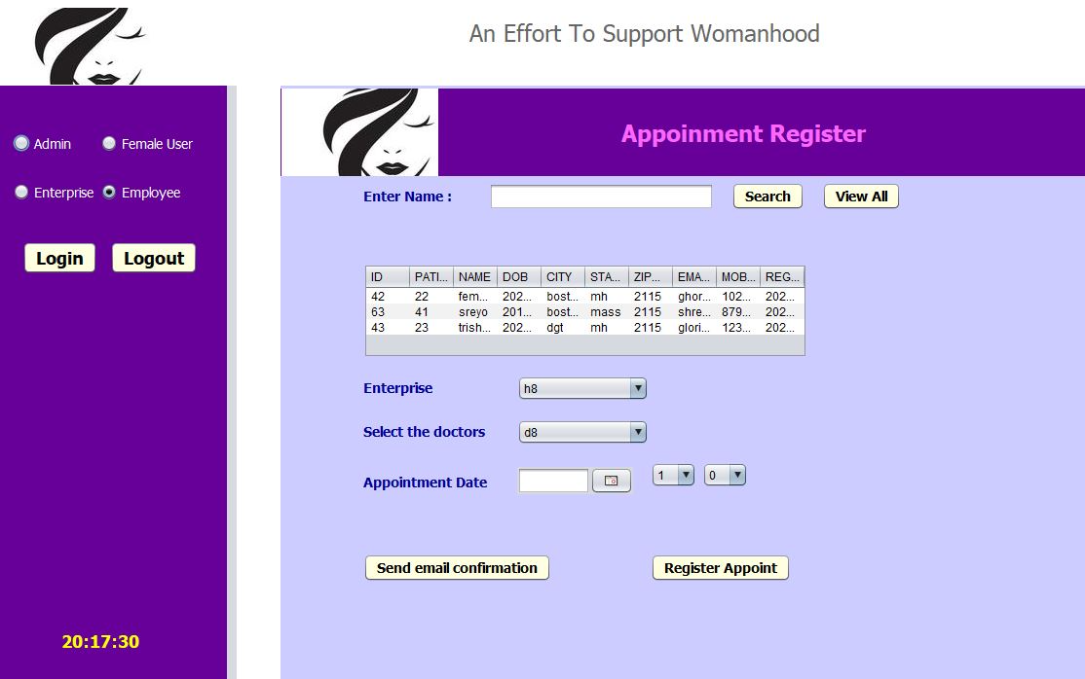

Slide 26
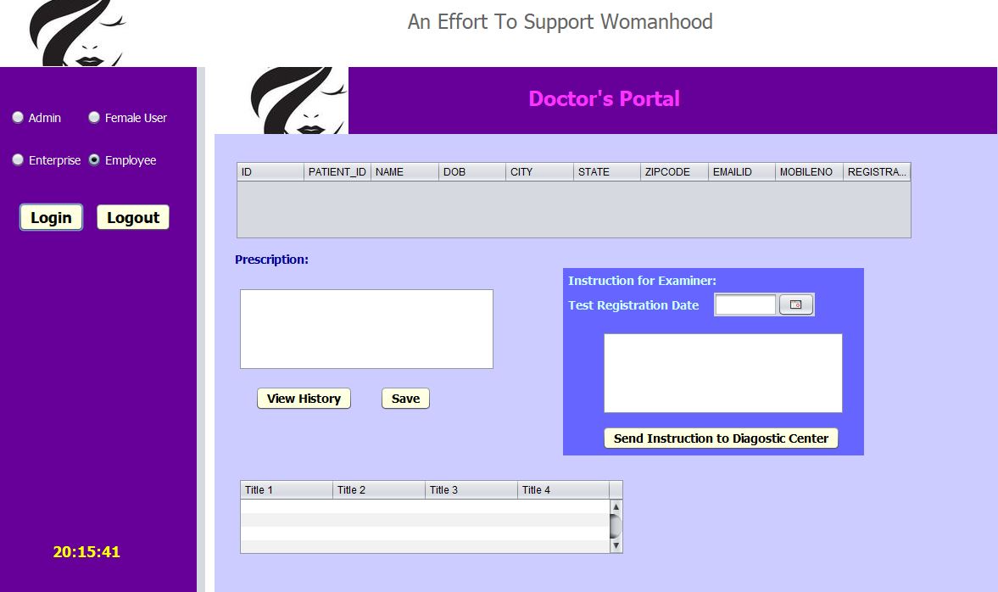
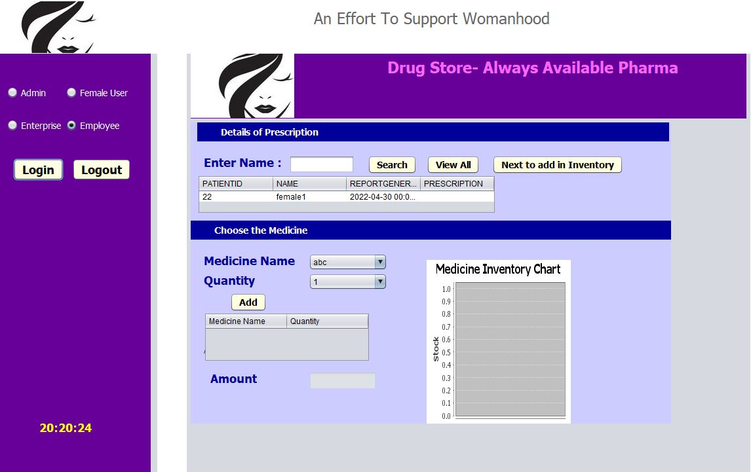

Slide 27
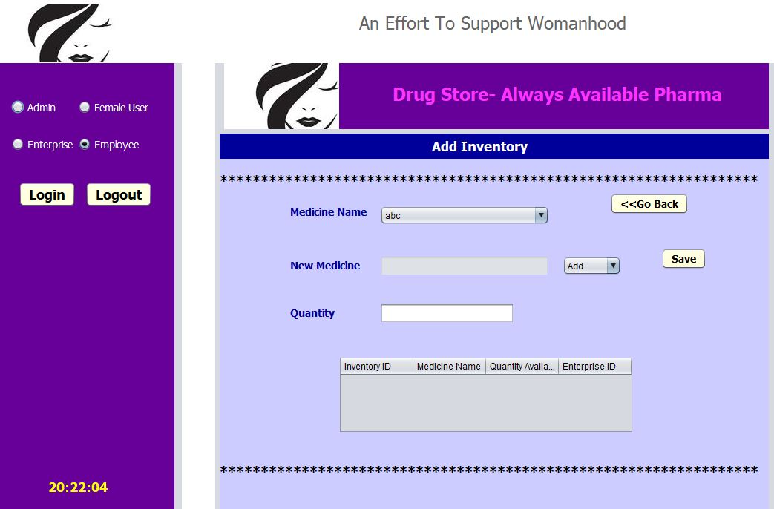
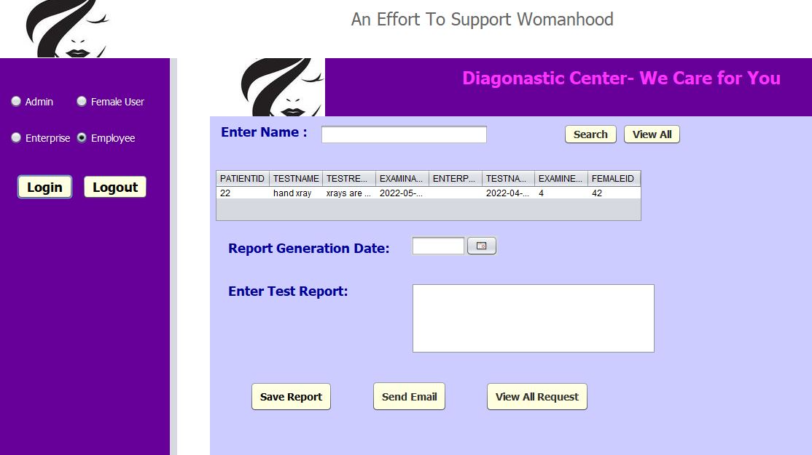

Slide 28
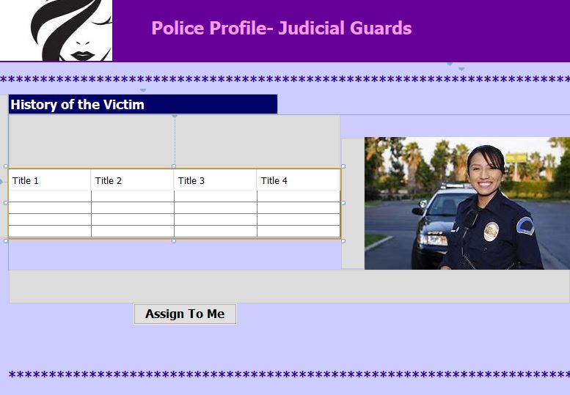
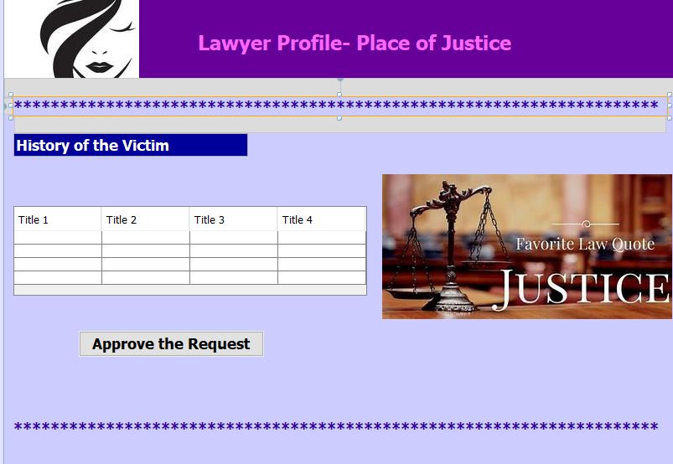

Slide 29
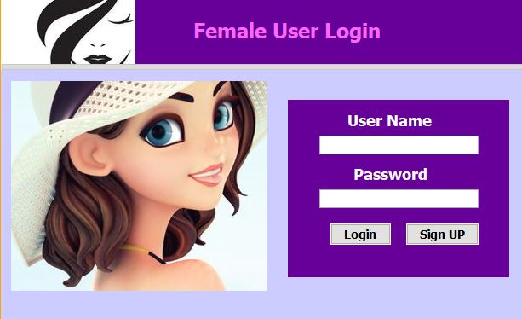
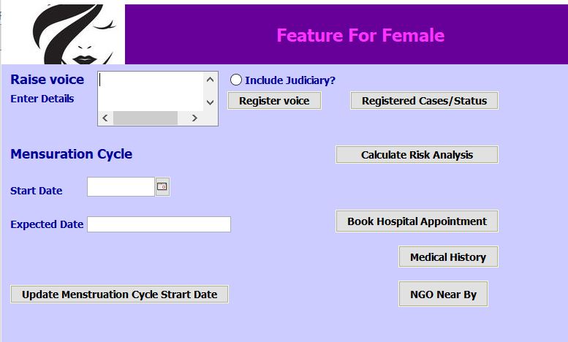

Slide 30
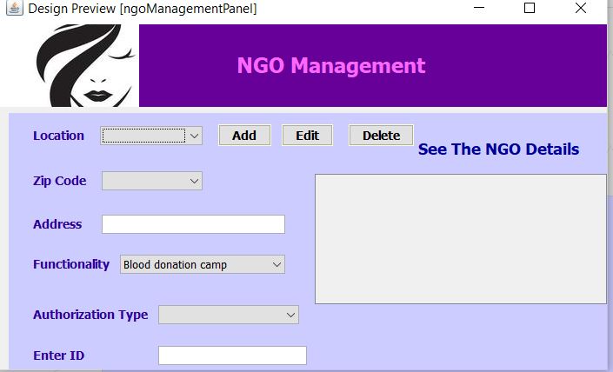

Slide 31
Thank you

